Slide 1
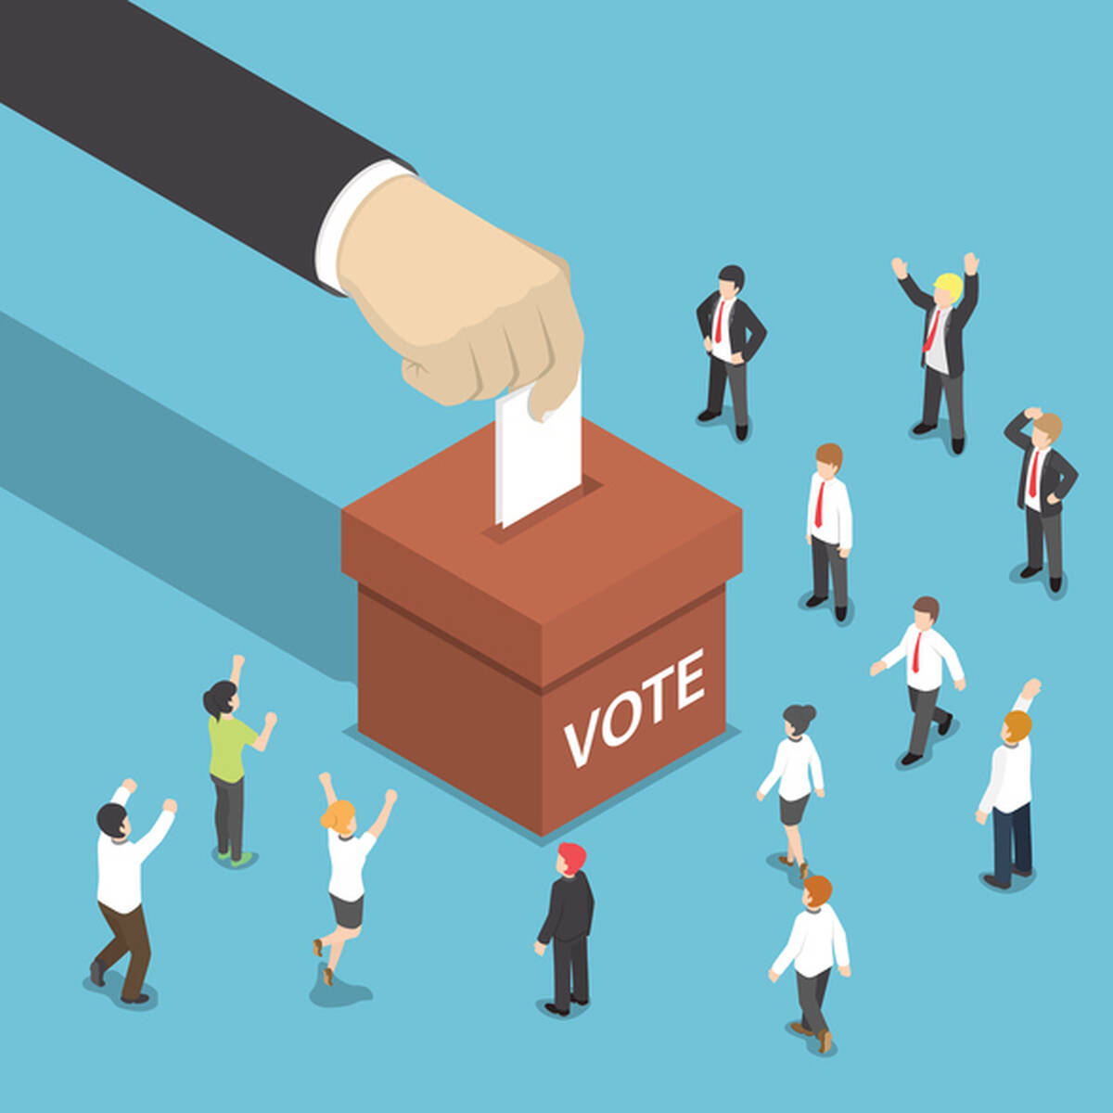
Importance of Voting

Slide 2
Introduction
Voting is the democratic process through which individuals express their preferences and elect representatives or make decisions on various issues.
Fundamental Role of Voting
Emphasizing Voting as a Sacred Duty, Privilege, and Responsibility

Slide 3
Foundation of Democracy
Democracy Relies on Citizen Participation
Voting as the Bedrock of Government
Citizens Shaping the Political System for Responsive Governance

Slide 4
Expressing Individual Voices
Voting as a Means of Expression
Each Vote as a Powerful Voice
Contributing to the Diverse Perspectives in Our Nation

Slide 5
Influencing Policies and Legislation
Voting's Impact Beyond the Ballot Box
Choosing Representatives Reflecting Our Values
Shaping Laws Defining Rights and Responsibilities

Slide 6
Protecting Civil Liberties
Voting as a Guardian of Civil Liberties
Honoring the Sacrifices of Past Advocates
Ensuring the Continuation of Freedom and Equality

Slide 7
Fostering Social Cohesion
Building a Healthy Democracy
Voting as a Unifying Force
Engaging in Dialogue and Empathy for an Inclusive Society

Slide 8
Holding Leaders Accountable
Voting as a Mechanism for Accountability
Leaders Responsive to the Will of the People
Checking Power for Transparency and Responsiveness

Slide 9
Addressing Systemic Issues
Voting as a Tool for Social Change
Electing Representatives Committed to Progress
Peaceful Means of Reforming the System

Slide 10
Enhancing Global Standing
Voting Reflecting a Vibrant and Engaged Citizenry
Contributing to National Strength and Credibility
Sending a Global Message of Values and Principles

Slide 11
Conclusion
Recap of the Importance of Voting
Emphasis on Duty, Responsibility, and Pride
Illuminating the Path to a Just and Equitable Future

Slide 12


